Slide 1
Regular Expression

Slide 2
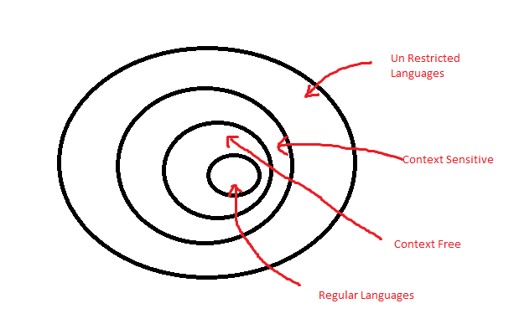
There are four types of languages:
Non-restricted types of languages
Context Sensitive languages
Context Free languages
Regular languages

Slide 3
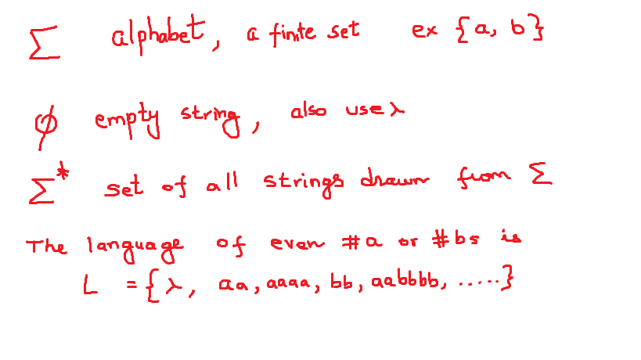

Language
A formal language is a set of strings composed from the alphabet.
What is an alphabet ?
The set of strings composed from the alphabets is written as

Slide 4
What are we doing ?
What are languages ?
How do you define a language ? strings, grammars,
How do you define a machine ( automata ) to accept the language ?
In this course, we will be dealing with regular languages that define strings and how do you develop a automaton to accept the language.

Slide 5
Regular expression
Regular expressions are a way of to express a regular language via a string representation
Regular expression generates strings in the language. That language is known as regular language.
For any language we define the alphabets, strings, and the rules governing the generation of strings.
We would not be dealing with grammars , that would be context free languages. Because regular language is a subset of CFL, CFL machines do accept regular languages, not vice versa.

Slide 6
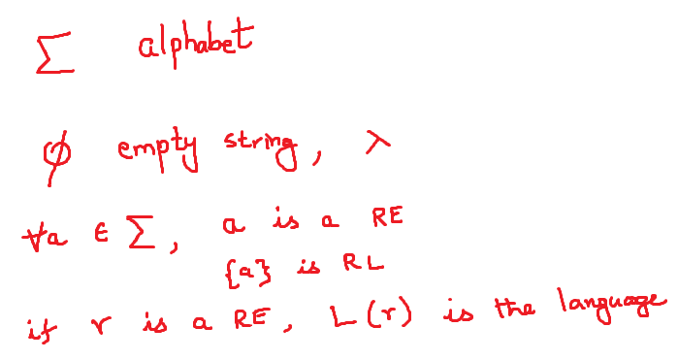
What is a regular language

Slide 8
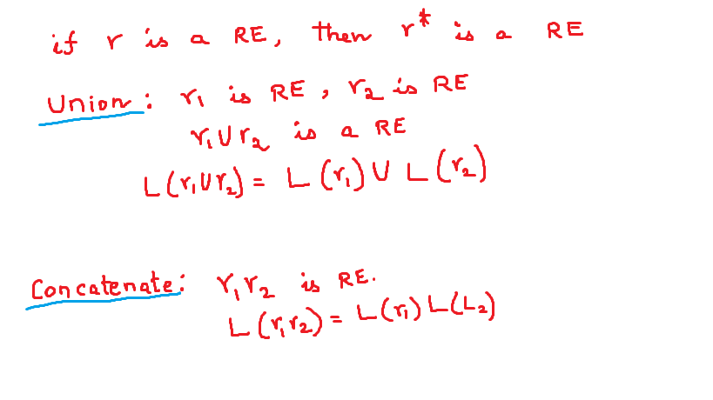

Slide 9
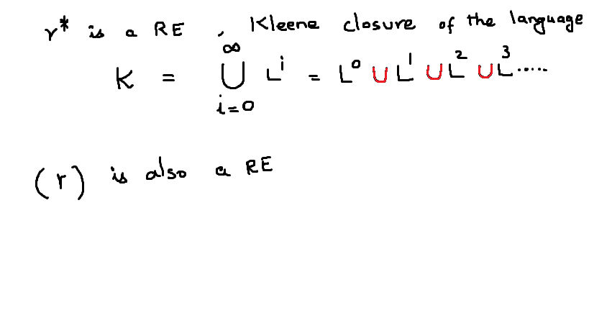

Slide 10
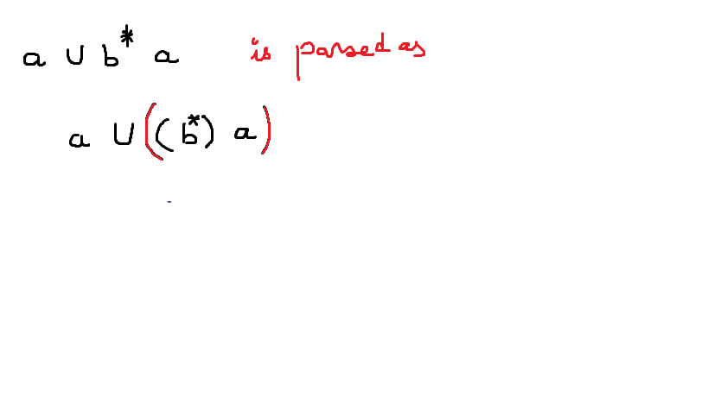
The order of precedence
( R )
R*
R₁R₂
R₁ U R₂

Slide 11
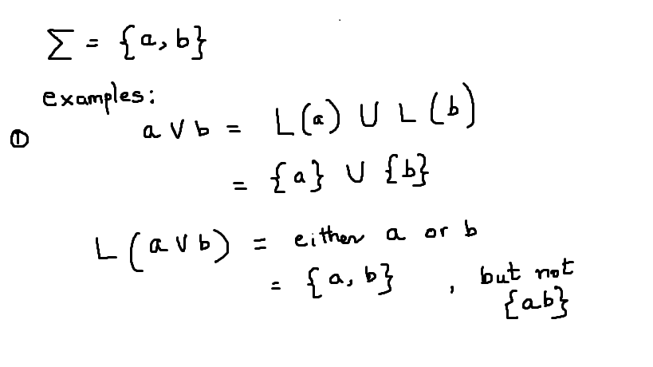

Slide 12
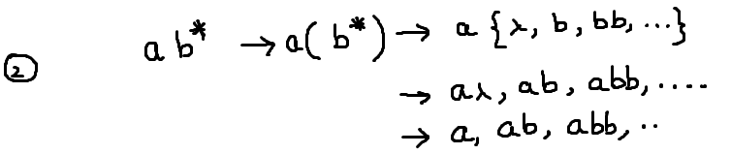

Slide 13
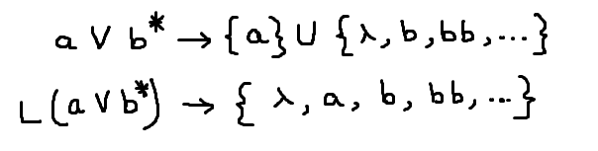

Slide 14
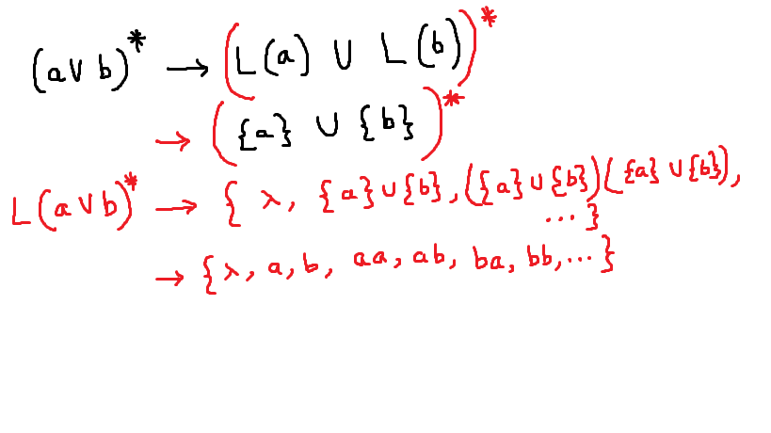

Slide 15
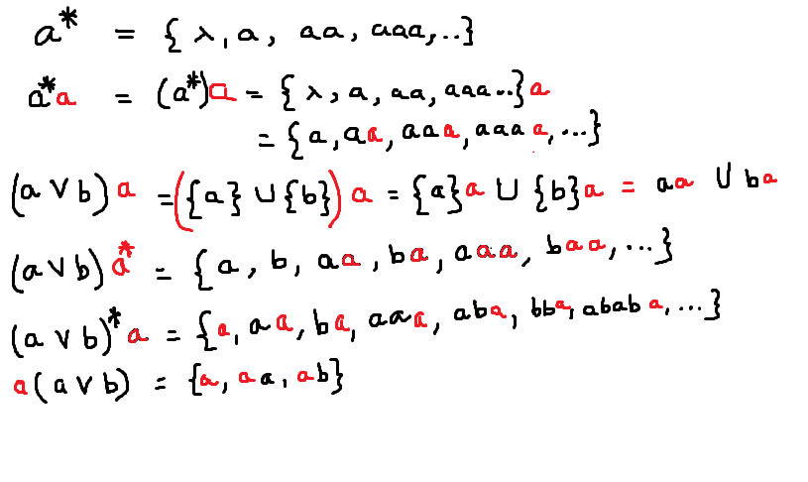
more examples

Slide 16
